Slide 1
Lecture 1: Introduction
Harbin Institute of Technology（Shenzhen）
School of Computer Science and Technology Zhang Meishan (mason.zms@gmail.com)
Copyright：Harbin Institute of Technology，Su Xiaohong， sxh@hit.edu.cn
Notes:
Good morning, everyone! Welcome to our course on High-level Language Programming. In this class, we will learn the foundational aspects of C++ and how to use it effectively in various programming scenarios.

Slide 2
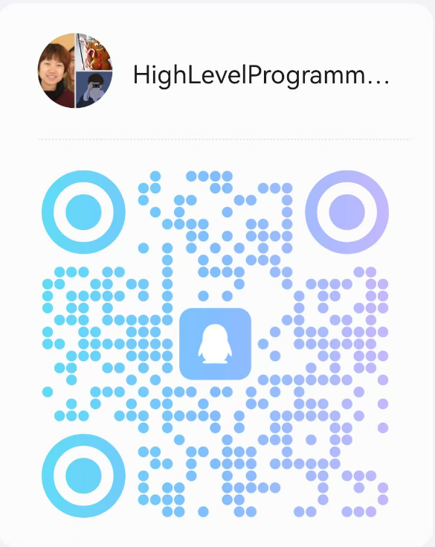
Basic Information
School of Computer Science and Technology
Teacher：Zhang Meishan
https://zhangmeishan.github.io/
Teacher Assistant：Jiaxin Xu， Jinpeng Huang，Yan Luo
Office：L1922
Course group number ： 892362595
Main textbooks ：《Learn C++ through English and Chinese》
--Paul Kelly, Su Xiaohong
Score：homework 20 points + experiment 40 points + final exam 40 points

Slide 3


Course Teaching Objectives
Mastering the fundamental approach to solving problems using computers
Mastering the basic knowledge of high-level language programming
Mastering the fundamental methods of computer software design and implementation
Having the ability to solve practical problems using computers and possessing basic programming debugging skills
How to Think
Like a Computer Scientist
How to program
Like a Computer Scientist
Notes:
In this course, we aim to achieve a few key objectives:
Mastering problem-solving with computers: This means learning how to approach a problem, break it down into smaller tasks, and use a computer to implement the solution.
Understanding high-level programming: C++ is a high-level language, and this course will help you master its syntax and concepts. You will also understand how to structure your programs logically.
Software design and implementation: We will dive into how software is designed from scratch, which is critical for creating effective, efficient, and maintainable programs.
Debugging and solving practical problems: By the end of this course, you should feel confident writing programs in C++, debugging your code, and solving real-world problems using the techniques you’ve learned.
By learning the course, you will develop the ability to think and code like a computer scientist.

Slide 4
First Lesson： Overview
What is a computer program?
How to develop a computer program?
The brief history of the C++ language
The common basic standards in the C++
How to use the online programming tool, e.g. "onlinegdb“
How to use the C++ programming tool
How to learn C++
Notes:
The first lesson teaching here is a brief introduction. Here is an overview, including seven parts.
What is a computer program?
How to develop a computer program?
The brief history of the C++ language
The common basic standards in the C++
How to use the online programming tool, e.g. "onlinegdb“
How to use the C++ programming tool
How to learn C++

Slide 5
1.1 What is a computer program?
computer program ：A computer performs all of these tasks by following a predefined set of instructions.
compiler
computer program
programming language
(high-level languages)
machine language
(low-level languages)
computer
cooker
recipe
nature language
Notes:
So, what is a computer program? In simple words, a program is a series of instructions that tell a computer how to perform specific tasks. These instructions are written in a programming language that the computer understands.
Think of a computer as a chef and the program as a recipe. The chef needs a clear set of steps (we call it instructions) to follow in order to prepare a meal.
We use programming languages, like C++, to write these instructions in a way that computers can execute. High-level languages are easier for us to write and read, while low-level machine languages are what the computer actually processes. Codes of high-level programming can be converted into low-level machine instructions by a compiler.

Slide 6
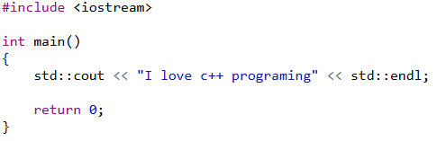
1.1 What is a computer program?
program language：
natural language：
Please print “I love c++ programing” onto the screen.
Notes:
Here is a simple example C++ code to print “I love c++ programing” onto the screen: six lines. (Please read)
As a comparison, the corresponding natural language for human to finish the same goal. (Please read)

Slide 7
1.2 Developing a computer program
Developing a computer program:
define and understand the problem to be solved----analysis phase
how is it to be done? -----design phase
writing, compiling and testing C++ programs.
Notes:
Developing a computer program involves several steps:
Define and understand the problem – This is the analysis phase.
Design a solution – In this phase, we plan how to implement the solution.
Write, compile, and test – This is where we write the actual code, compile it, and ensure it runs without errors.

Slide 8
1.2 Developing a computer program
Program development cycle
Step 1: Design the program.
Each program has to be individually designed to implement the overall solution developed at the analysis and design phases.
check its logic before starting to write the program
Step 2: Write the program.
the C++ program instructions are typed into a file using a text editor
source code or the program code source file
Notes:
We follow a cycle of designing, coding, testing, and debugging to ensure our program works as expected.
1. Design: First, you need to design your program and think about its overall structure.
2. Write: Then, you write the C++ instructions, which we call the source code.

Slide 9
1.2 Developing a computer program
Step 3: Compile the program.
translate the C++ program instructions to machine instructions through a compiler--object code, and stores the object code in an object file.
errors ---- compile-time syntax error: missing punctuation , misspellings,…
warning message: not as serious as a syntax error, not prevent the program from being compiled, may be a problem and should be investigated
Step 4: Link the program.
combining the object file of the program with other object files from the C++ run-time library to form an executable file
Notes:
3. Compile: You compile the program, which means translating it into machine code.
4. Link: After that, the object code is linked with other code from libraries to create an executable file.

Slide 10
1.2 Developing a computer program
Step 5: Test the program.
run-time error—causes the program to stop before it has completed its task
logic errors(bugs)---The program may complete its task but produce incorrect results
Step 6: Debug the program.
The process of locating and correcting program errors is called debugging
Many compilers have tools that can be used to help locate bugs
Correcting bugs involves going back to step 2, try to catch errors as early as possible
Notes:
5. Test: Test the program to ensure it runs correctly.
6. Debug: If there are errors, you need to locate and fix them. This process is called debugging.

Slide 11
1.2 Developing a computer program
Program development cycle
Design
propose an overall solution
Write
write C++ program instructions→source file
correct run-time error
translates C++ program instructions into machine instructions→object file
Compile
Link
combines the object file with the C++ run-time library files→executable file
Correct
Test
verify program errors (bugs)
Debug
locate and correct bugs
Notes:
Once we have written the source code, we need to compile it. The compiler translates the high-level C++ instructions into machine instructions, which are called object code.
If the compiler detects any syntax errors, such as spelling mistakes or missing some keywords, it won’t compile the program until the errors are fixed. Sometimes the compiler also gives warnings that don’t stop the compilation but should still be noticed.
After compiling, we link the object code with other necessary files, such as those from the C++ runtime library, to create an executable file.
Once the program is compiled and linked, it’s time to test it. During this phase, we look for two types of errors:
Run-time errors: These cause the program to stop unexpectedly.
Logic errors: These don’t stop the program but cause it to produce incorrect results.
When we find these errors, we go back to the debugging phase, where we fix the issues and run the program again.

Slide 12
1.3 Brief history of C++
1972，AT&T, Bell Lab. Dennis Ritche, C programming language
1980, Bell Lab. Bjarne Stroustrup, “C with Classes”
1983, C++ was developed by Bjarne Strostrup at AT&T Bell Laboratories
1985, the first commercial version of C++
1997, ANSI (American National Standards Institute) C++ (standard C++)
C++ is always evolving !!!
Notes:
To understand C++, it’s useful to know its history.
In 1972, Dennis Ritchie at AT&T Bell Labs created the C programming language.
Then, in 1980, Bjarne Stroustrup developed “C with Classes”, which added object-oriented features to C.
By 1983, this evolved into C++, which became the standard for object-oriented programming.
The first commercial version of C++ was released in 1985, and it continued to evolve over the years.
In 1997, the ANSI (American National Standards Institute) adopted the C++ standard, ensuring consistency in how the language was used across platforms.
C++ continues to evolve, and staying up to date with its latest features is important for any programmer.

Slide 13
1.4 Common standards in the C++
The example programs used in this book conform to the ANSI/ISO C++ standard.
Not all compilers conform to this standard, so some compilers may not correctly compile the example programs.
Some of the example programs may have to be modified for use with these other compilers.
See the web site for details.
Notes:
The programs we write in this course will adhere to the ANSI/ISO C++ standard. This ensures that the code is compatible across different platforms and compilers. However, not all compilers fully conform to this standard.

Slide 14
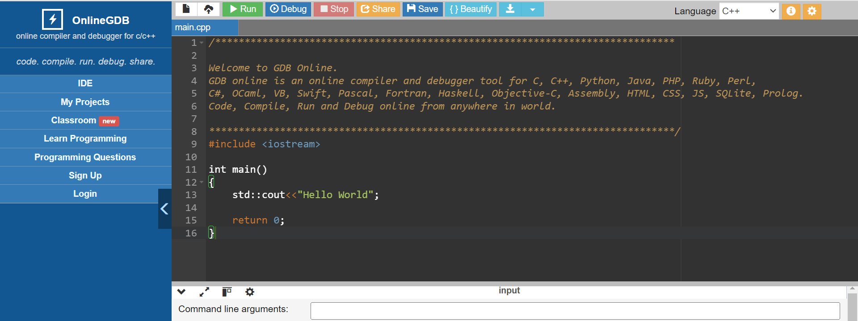
1.5 Online Programming
onlinegdb: https://www.onlinegdb.com/
Notes:
Now that we have an understanding of what a program is and how it’s developed, let’s talk about the tools we’ll use for writing and running our C++ code.
For online programming, I highly recommend using OnlineGDB. It’s a free, web-based IDE that supports C++ and many other languages. This is a great tool for beginners because it’s easy to set up – you don’t need to install anything on your computer. Just open the website, start coding, and run your programs instantly.

Slide 15
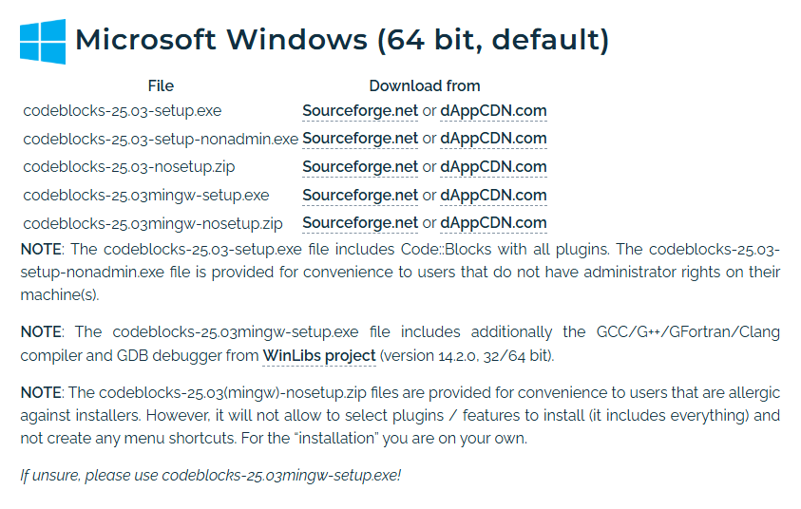
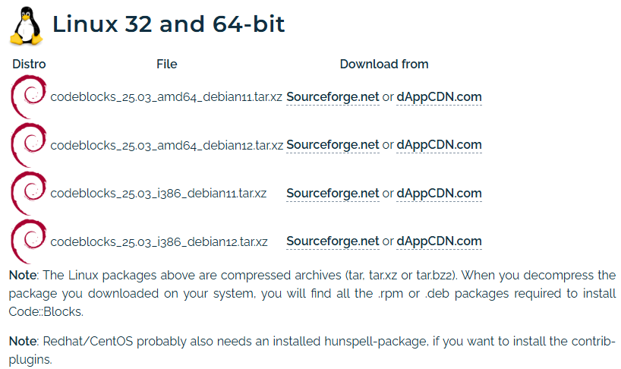

1.6 Offline Programming
CodeBlocks
download CodeBlocks and install it
Notes:
For offline programming, you have several options. One of the most popular tools is CodeBlocks, which is an IDE (integrated development environment) specifically designed for C++.
Here’s how to get started with CodeBlocks:
1.Download the installer from the official website.

Slide 16
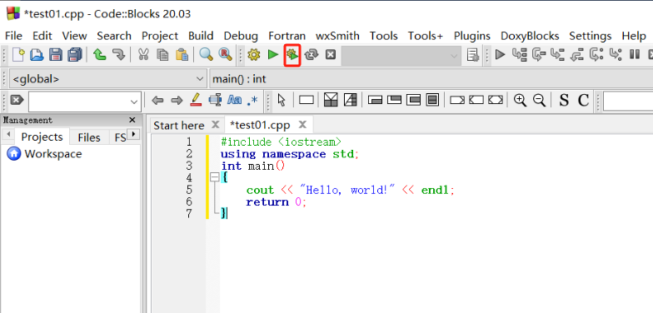
1.6 Offline Programming
CodeBlocks
The installation package includes the compilation environment, and the installation will automatically find the environment path. Therefore, you can directly create new files to write and run C++ programs.
Notes:
2.Install it on your system. The installation package includes the compiler, so once installed, CodeBlocks will automatically set up the environment paths.
3.After installation, you can create new files and start coding in C++ right away.
4.Using CodeBlocks gives you more control and allows you to work without an internet connection, which is essential for larger projects.

Slide 17
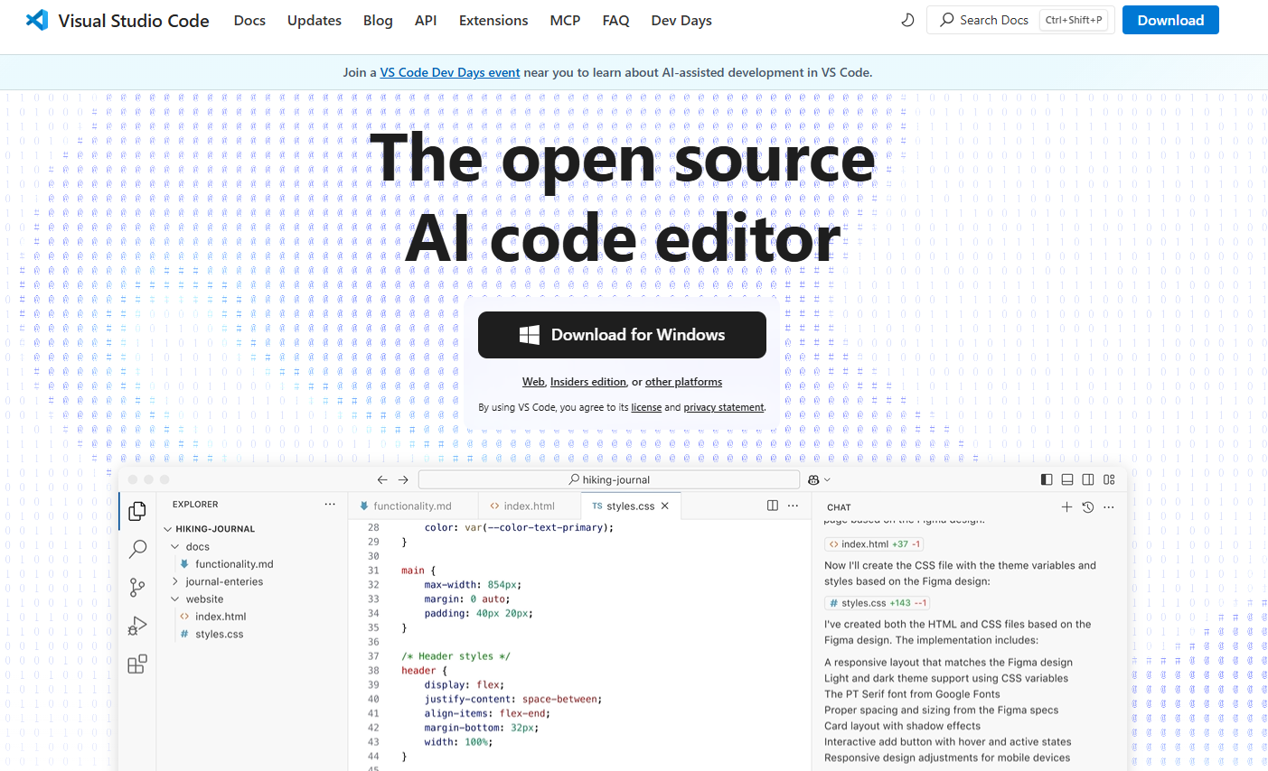
1.6 Offline Programming
Visual Studio Code
1. download Visual Studio Code and install it
Notes:
Another excellent option for offline programming is Visual Studio Code. It’s a powerful, lightweight code editor developed by Microsoft that supports a wide range of languages, including C++.

Slide 18
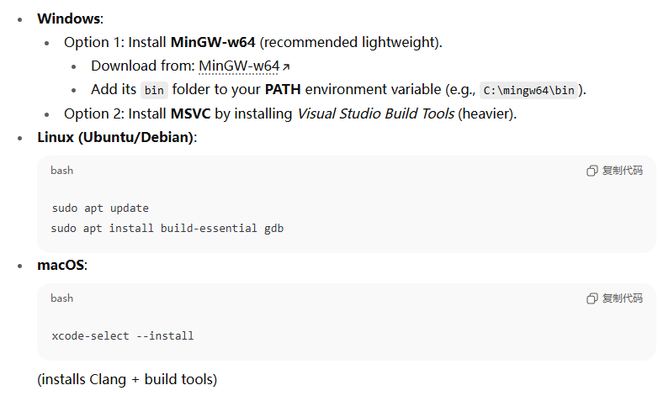
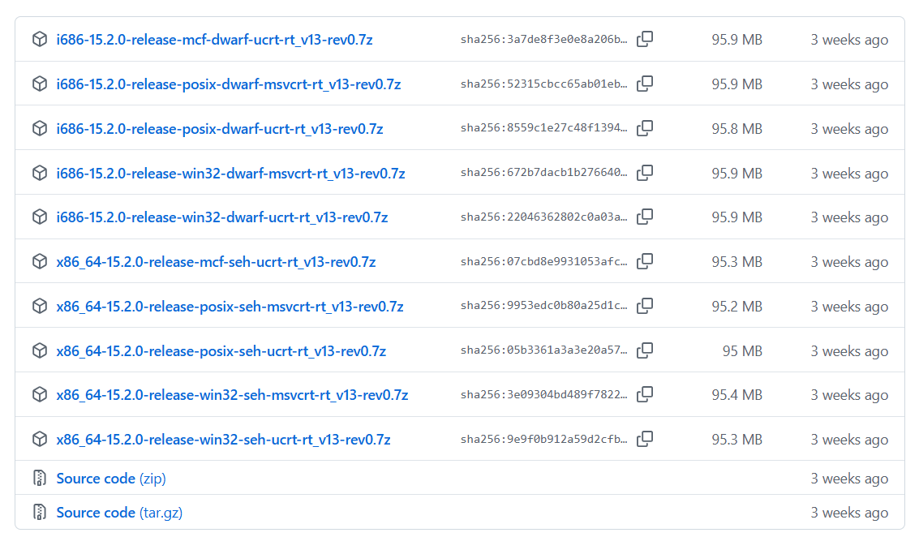
1.6 Offline Programming
2. download MinGW-W64 and install it
VS Code is just an editor — you need a compiler:
Notes:
To set up Visual Studio Code for C++ programming, follow these steps:
1.Open Visual Studio Code official website.
2.Download and install MinGW-W64, which provides a complete compiler toolchain for C++.

Slide 19
1.6 Offline Programming
3. After finishing the installation, open MSYS2 and enter the following command to install the toolchain:
4. Configure system environment variables
pacman -S --needed base-devel mingw-w64-ucrt-x86_64-toolchain
Open the Control Panel
Click "System and Security"
Click "System"
Click "Advanced system settings"
Click " environment variables "
Add MSYS2 bin path to user variables path
MSYS2 bin path : installation path of MSYS2 + ucrt64\bin
for example, C:\msys64\ucrt64\bin
Notes:
3.After installing above two things, you’ll need to configure system environment variables to include the path to MinGW’s binaries. This allows it to compile and run C++ files. Here is the instruction step by step.
4. You can use the following commands to test the installation of environment:

Slide 20
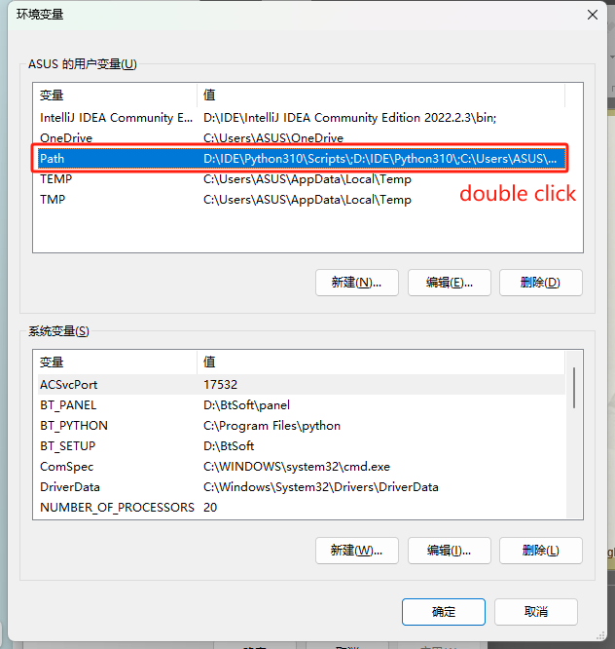
1.6 Offline Programming

Slide 21
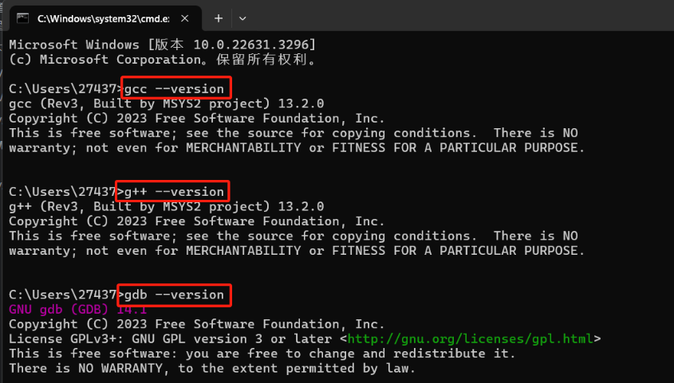
1.6 Offline Programming
5. use the following commands to test the installation of environment:
Notes:
5. Open Visual Studio Code and install the C++ extension from the extensions marketplace.

Slide 22
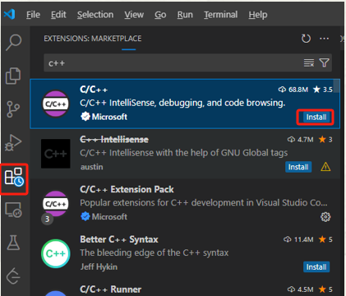
1.6 Offline Programming
6. open Visual Studio Code, search for "C++" in extensions and install it:
Open VS Code → go to Extensions (Ctrl+Shift+X) → install:
C/C++ (by Microsoft) → provides IntelliSense, debugging.
C/C++ Extension Pack (optional, includes debugger and more).
Code Runner (optional, for quick running code).
Notes:
6. It’s important to test whether the environment is working correctly. You can do this by running a simple C++ program to make sure the compiler and tool are functioning well.

Slide 23
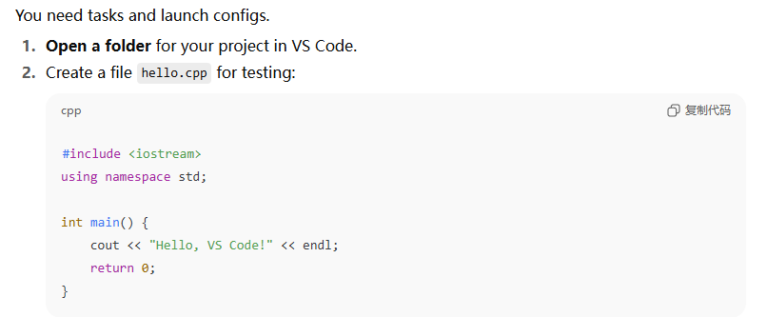
1.6 Offline Programming
7. test whether vscode can run c++ files

Slide 24
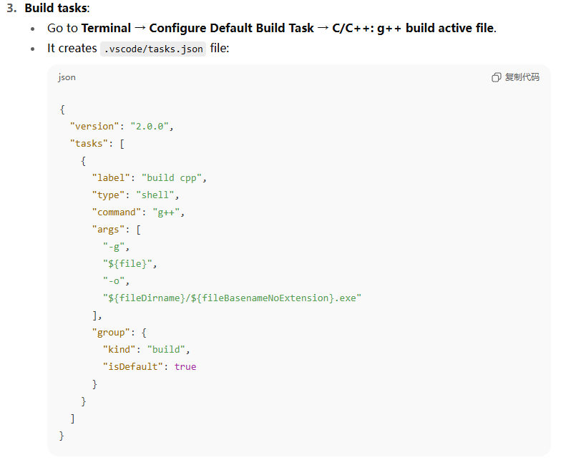
1.6 Offline Programming
7. test whether vscode can run c++ files

Slide 25
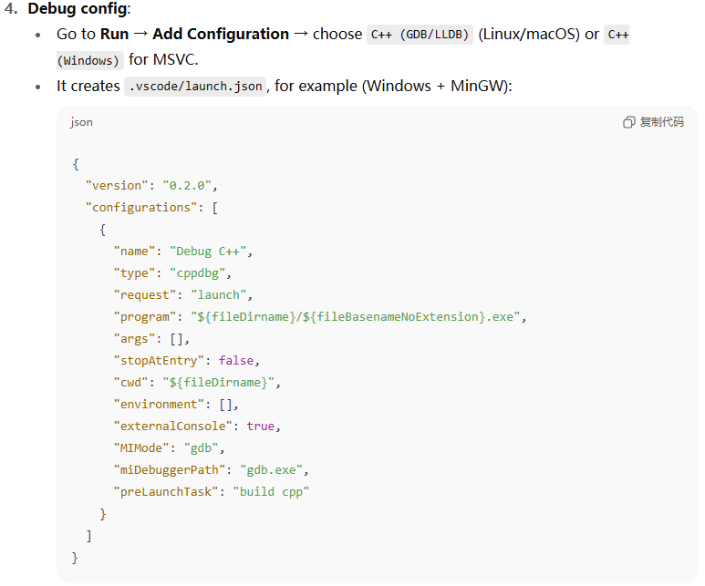
1.6 Offline Programming
7. test whether vscode can run c++ files

Slide 26
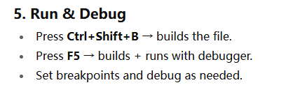
1.6 Offline Programming
7. test whether vscode can run c++ files

Slide 27
1.7 Learning C++
A successful approach to learning to program in C++ depends on large amounts of practice.
exercises at the end of each chapter.
solutions to selected exercises are at the web site for this book
http://www.hxedu.com.cn.
Other learning materials
Learn C++ – Skill up with our free tutorials (learncpp.com)
https://www.bilibili.com/video/BV1oD4y1h7S3/?spm_id_from=333.337.search-card.all.click&vd_source=1e2cfa9e6c262e6d189fe4a48f2c1aac
Learn C++ | Codecademy
Notes:
The best way to learn C++ is through practice. No amount of reading or watching tutorials can replace hands-on coding experience. In this course, we’ll have plenty of opportunities for you to practice what you learn.
It’s important to solve as many problems as possible and write a lot of code. The more you practice, the more proficient you’ll become at thinking and solving problems like a C++ programmer.
In addition to the textbook and classroom materials, there are plenty of external resources to help you improve your C++ skills. You’ll also find additional resources online with the following links.
I encourage you to explore these resources in your free time to get more comfortable with the language. Coding more will help you understand the concepts more deeply.

Slide 28

Thank you for
your attention !
Q&A
ZhangMeiShan

Slide 29
Homework
1. How to develop a C++ program?
2. Use CodeBlocks, Visual Studio Code or online programming to write a C++ program:
Display the following two sentences on the screen:
Hello C++.
I like programming.
The output is formatted as two lines.
Notes:
At the end of each chapter in the textbook, there are exercises to help reinforce your understanding.
This is the end of the lecture. Make sure you explore these tools and resources in your spare time, because they are critical to building a strong foundation in C++.
And feel free to ask me your questions.

